Slide 1
SER 334 A Session
SI Session
Sunday, February 18th 2024
7:00 pm - 8:00 pm MST

Slide 2
{
Agenda
Review CPU Scheduling
Review Paging
Virtual Memory
Sample Problems

Slide 3
SI Session Expectations
Thanks for coming to the SER 334 SI session. We have a packed agenda and we are going to try to get through as many of our planned example problems as possible. This session will be recorded and shared with others.
If after this you want to see additional examples, please visit the drop-in tutoring center.
We will post the link in the chat now and at the end of the session.
tutoring.asu.edu
Please keep in mind we are recording this session and it will be made available for you to review 24-48 hours after this session concludes.
Finally, please be respectful to each other during the session.

Slide 4

Interact with us:
Zoom Features
Zoom Chat
Use the chat feature to interact with the presenter and respond to presenter’s questions.
Annotations are encouraged

Slide 5
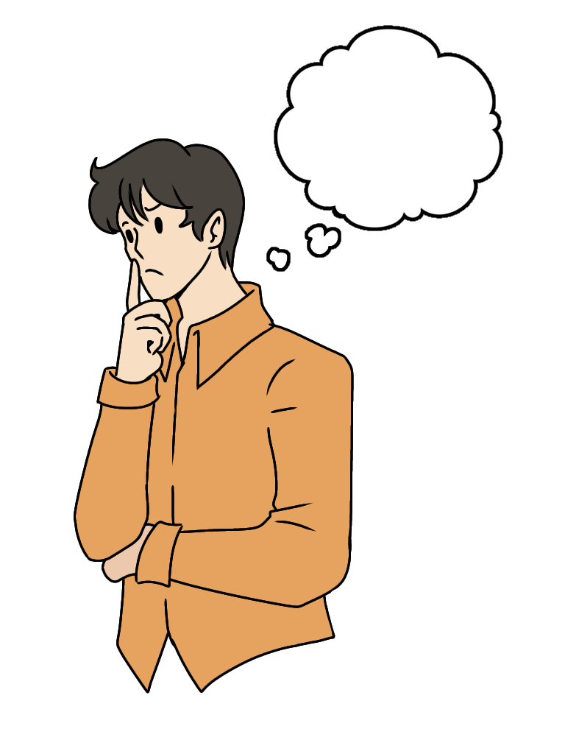
Can we name all the CPU Scheduling algorithms we covered?
SER 334
CPU Scheduling
11 total
Notes:
First come first served
Shortest job first
Shortest job first LIVE
Priority
Round robin
Multilevel queue
Multilevel Feedback Queue
Periodic/Priority Based
Rate-Monotonic
Earliest Deadline First
Proportional Share

Slide 6
Physical Memory
Three Types of Hole Selection:
SER 334
Memory
OUR DATA
Occupied
First Fit
Occupied
Goal is to find a place to put our data; so we need to find…
Best Fit
Occupied
Occupied
Worse Fit
A HOLE
Notes:
First one I can fit into
One closest to my size
Biggest hole, makes the next hole bigger

Slide 7
Two Methods for Memory Mapping…
Physical Memory
SER 334
Memory
1
1
2
2
3
3
4
4
Segmentation or Paging?
Split our program into chunks

Slide 8
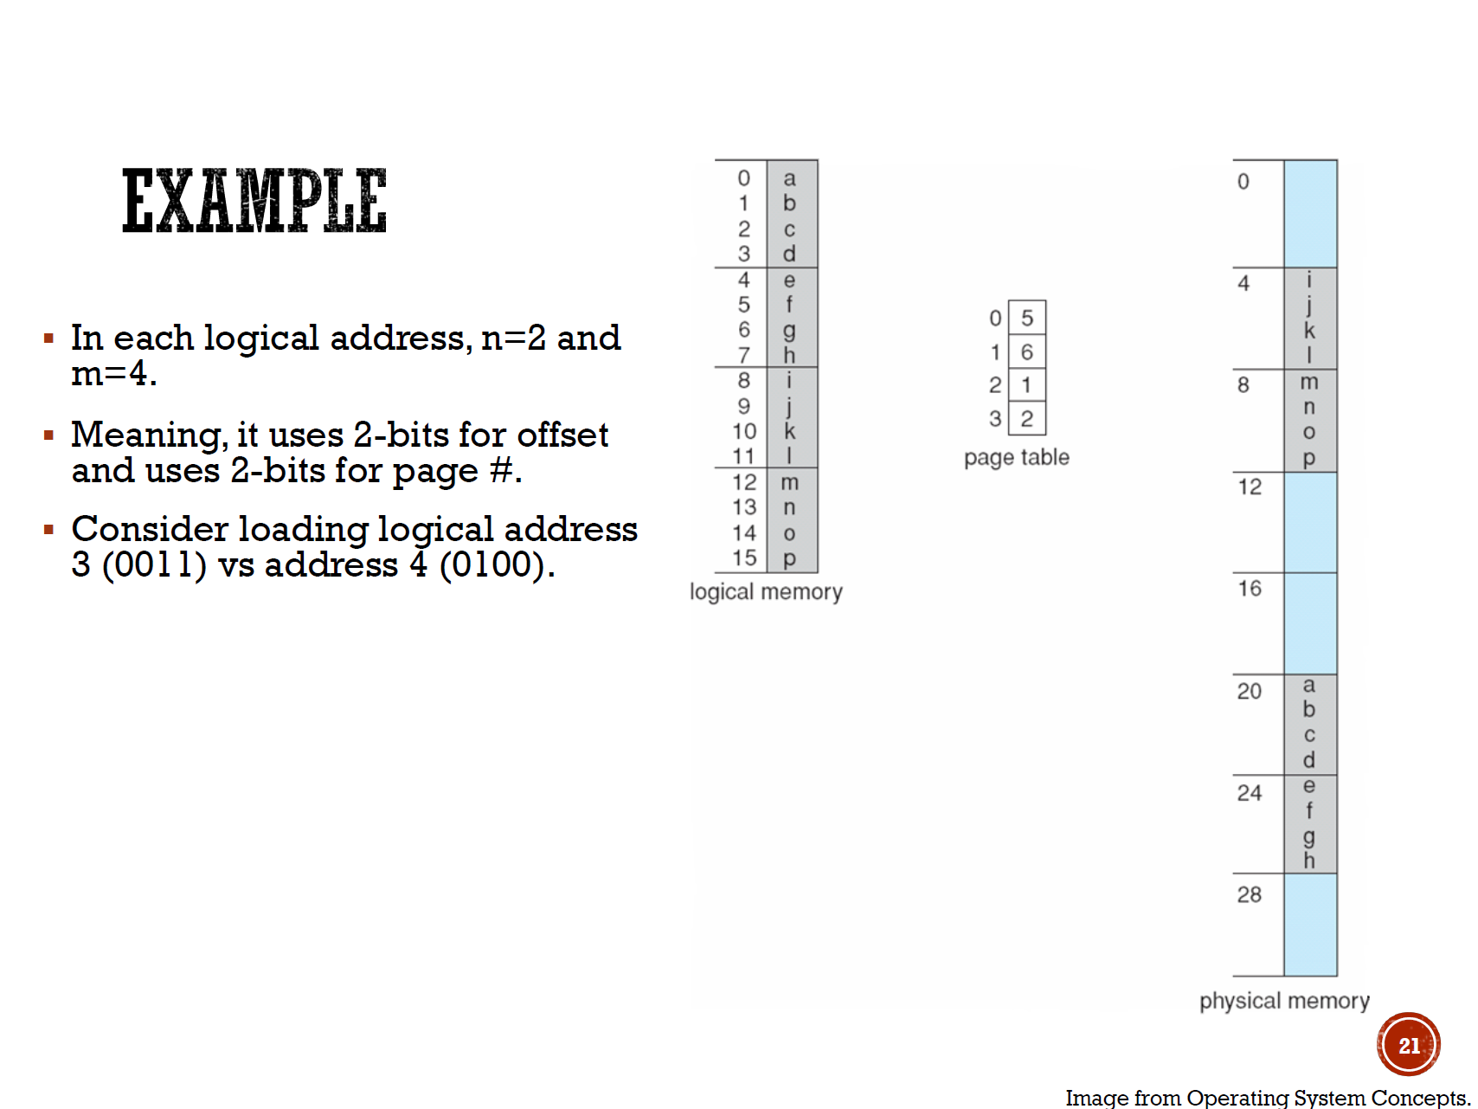
M
SER 334
Logical Address
Paging
Logical Address Size: 2^{M}
Page Size: 2^{N}
Pg #
Offset
M-N
N
11
01
How do we feel about paging?

Slide 9
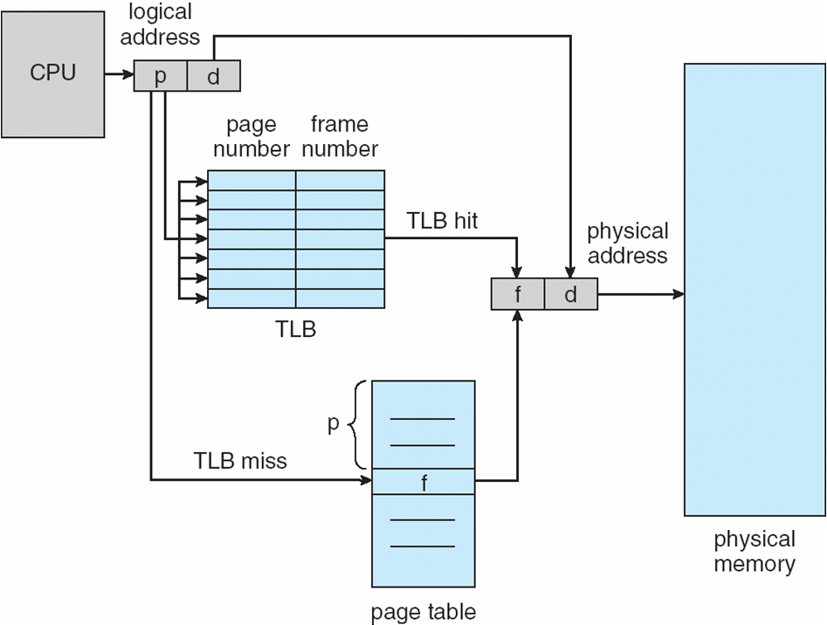
SER 334
Paging
🐢

Slide 10
SER 334
Paging
Some stuff is “wired down”
Suggestions for ways to remember the difference?
🐢
Notes:
OS based stuff

Slide 11
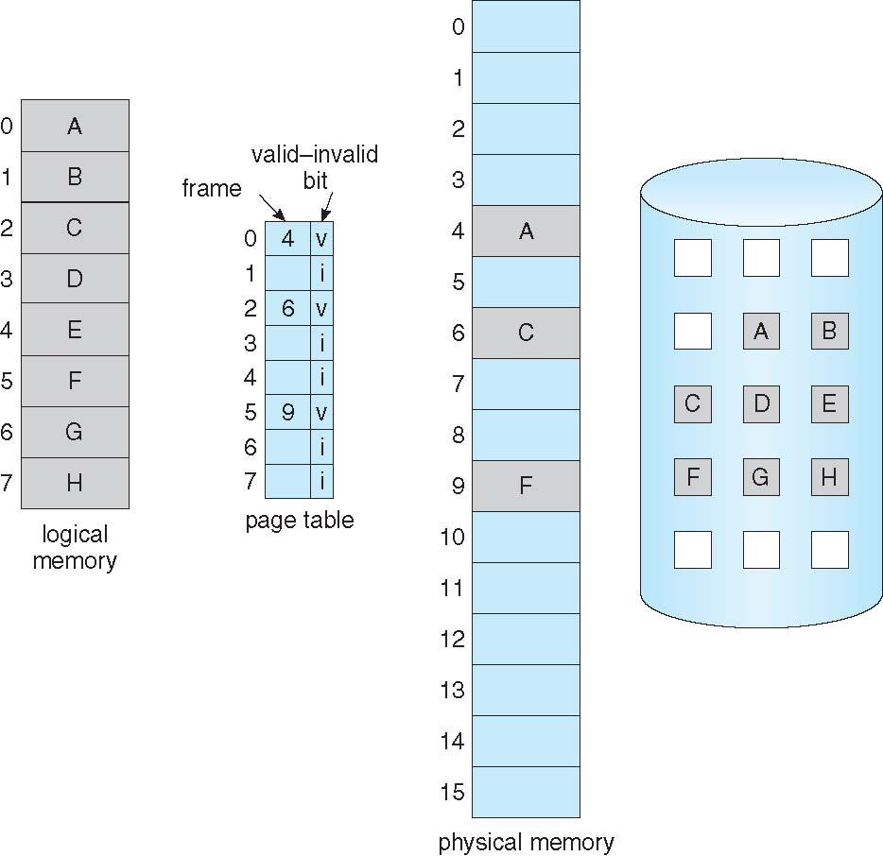
Backing Store / Secondary Storage
SER 334
Virtual Memory
Allows us to act as if memory was unlimited!

Slide 12
SER 334
Virtual Memory
A
B
C
D
Allows us to act as if memory was unlimited!
E
F
G
Notes:
More slots in backing store than in physical memory

Slide 13
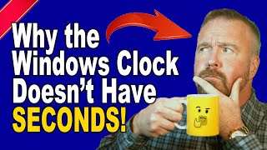
SER 334
Page Faults

Slide 14
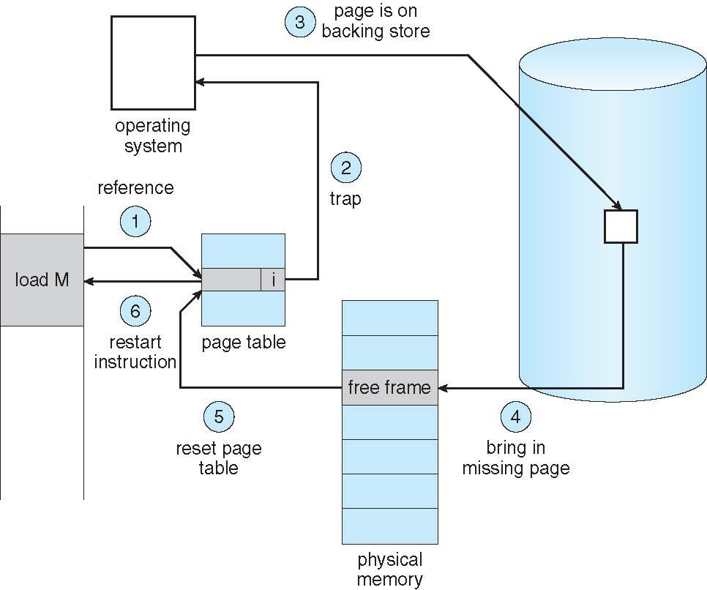
SER 334
Page Faults

Slide 15
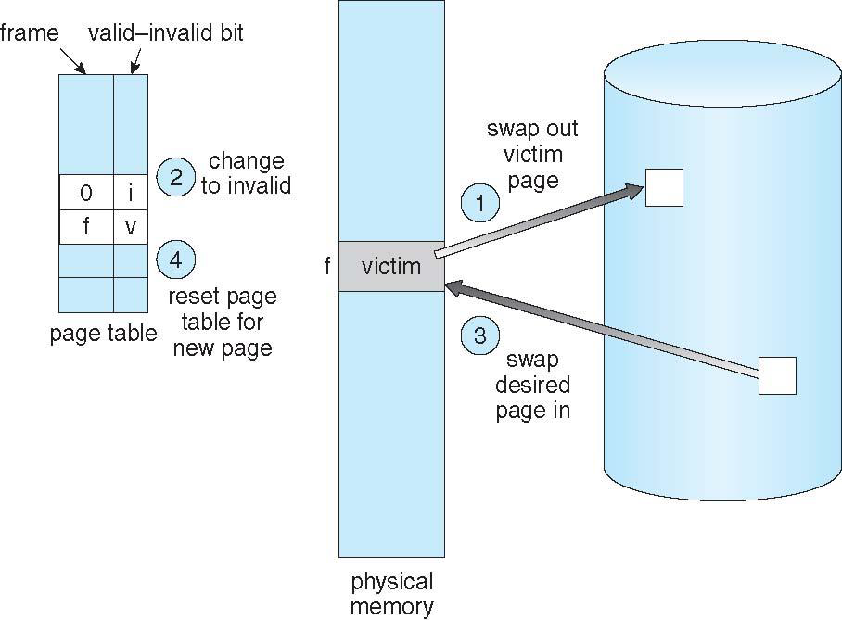
SER 334
Virtual Memory

Slide 16
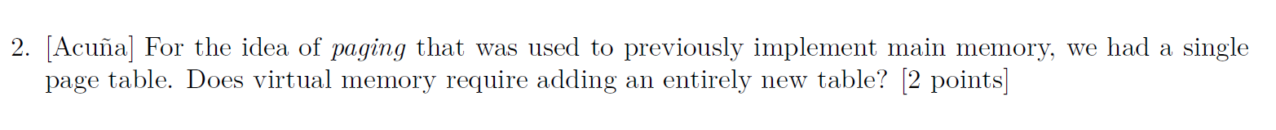
SER 334
Practice Problems

Slide 17
SER 334
Practice Problems
Notes:
Compulsory misses on first load!

Slide 18
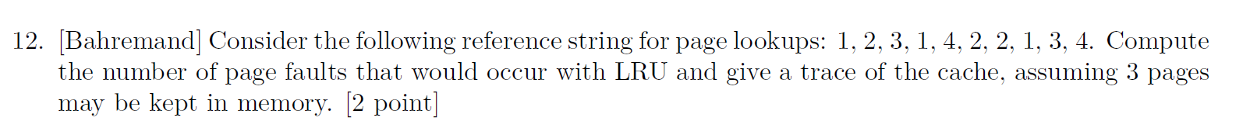
SER 334
Practice Problems

Slide 19
SER 334
Practice Problems

Slide 20
SER 334
Practice Problems
1
1
x

Slide 21
SER 334
Practice Problems
1
2
1 | 1
 | 2
x | x

Slide 22
SER 334
Practice Problems
1
2
3
1 | 1 | 1
 | 2 | 2
 |  | 3
x | x | x

Slide 23
SER 334
Practice Problems
1
2
3
1
1 | 1 | 1 | 1
 | 2 | 2 | 2
 |  | 3 | 3
x | x | x | ✔

Slide 24
SER 334
Practice Problems
1
2
3
1
4
1 | 1 | 1 | 1 | 1
 | 2 | 2 | 2 | 4
 |  | 3 | 3 | 3
x | x | x | ✔ | x

Slide 25
SER 334
Practice Problems
1
2
3
1
4
2
1 | 1 | 1 | 1 | 1 | 1
 | 2 | 2 | 2 | 4 | 4
 |  | 3 | 3 | 3 | 2
x | x | x | ✔ | x | x

Slide 26
SER 334
Practice Problems
1
2
3
1
4
2
2
1 | 1 | 1 | 1 | 1 | 1 | 1
 | 2 | 2 | 2 | 4 | 4 | 4
 |  | 3 | 3 | 3 | 2 | 2
x | x | x | ✔ | x | x | ✔

Slide 27
SER 334
Practice Problems
1
2
3
1
4
2
2
1
1 | 1 | 1 | 1 | 1 | 1 | 1 | 1
 | 2 | 2 | 2 | 4 | 4 | 4 | 4
 |  | 3 | 3 | 3 | 2 | 2 | 2
x | x | x | ✔ | x | x | ✔ | ✔

Slide 28
SER 334
Practice Problems
1
2
3
1
4
2
2
1
3
1 | 1 | 1 | 1 | 1 | 1 | 1 | 1 | 1
 | 2 | 2 | 2 | 4 | 4 | 4 | 4 | 3
 |  | 3 | 3 | 3 | 2 | 2 | 2 | 2
x | x | x | ✔ | x | x | ✔ | ✔ | x

Slide 29
SER 334
Practice Problems
1
2
3
1
4
2
2
1
3
4
1 | 1 | 1 | 1 | 1 | 1 | 1 | 1 | 1 | 1
 | 2 | 2 | 2 | 4 | 4 | 4 | 4 | 3 | 3
 |  | 3 | 3 | 3 | 2 | 2 | 2 | 2 | 4
x | x | x | ✔ | x | x | ✔ | ✔ | x | x

Slide 30
SER 334
Scratch Space

Slide 31
SER 334
Scratch Space

Slide 32
SER 334
Scratch Space

Slide 33
Upcoming Events
SI Sessions:
Monday, February 19th at 7:00 pm MST
Sunday, February 25th at 7:00 pm MST - Q&A Session before Exam 3
Review Sessions:
Exam 3 Review: Thursday, February 22nd at 7:00 pm MST

Slide 34

Questions?
Survey:
http://bit.ly/ASN2324

Slide 35


More Questions?
Check out our other resources!
tutoring.asu.edu
1-
2-
Click on ‘Go to Zoom’ to log onto our Online Tutoring Center.
Click on ‘View the tutoring schedule’ to see when tutors are available for specific courses.

Slide 36
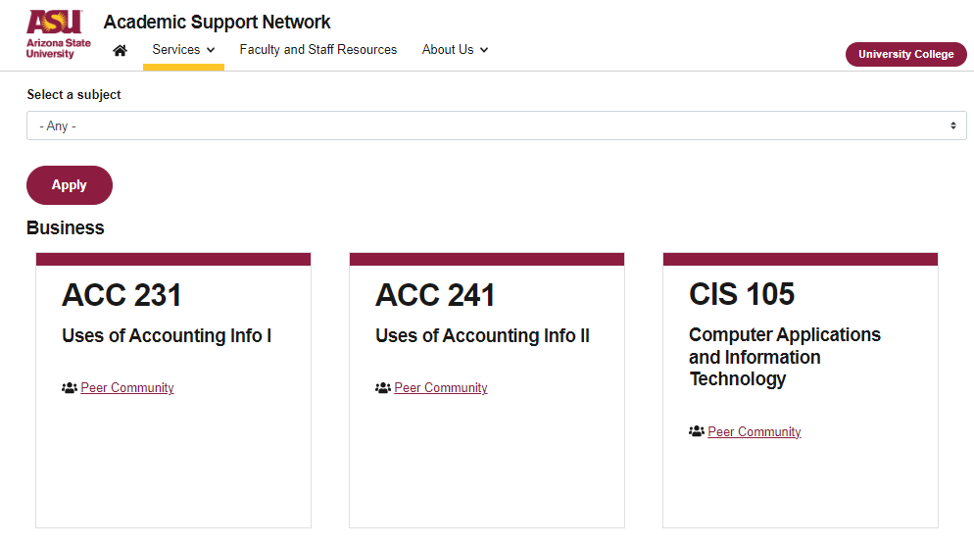

More Questions?
Check out our other resources!
tutoring.asu.edu/online-study-hub
Don’t forget to check out the Online Study Hub for additional resources!

Slide 37


Expanded Writing Support Available
Including Grammarly for Education, at no cost!
tutoring.asu.edu/expanded-writing-support
*Available slots for this pilot are limited

Slide 38
Additional Resources
Course Repo
Course Discord
BMP File Format (Wiki)
Linux Kernel API
Bootlin - Linux Cross Referencer
Dining Philosophers Interactive
Producer/Consumer Visual
Dave’s Garage Memory Video

